Slide 1
CUDA
Instructor
Dr. B Krishna Priya

Slide 2
Outline
The Age of Parallel Processing
Central Processing Units
The Rise of GPU Computing
A brief history of GPUs
Early GPU computing, CUDA: What is CUDA architecture
using the CUDA architecture
Applications of CUDA
Medical Imaging
Computational Fluid Dynamics
Environmental Science

Slide 3
Agile of Parallel Processing
2010- Computers are shipped with multicore central processor. Example:
Dual-core
low-end netbook machines to 8- and 16-core
workstation computers- supercomputer/ mainframe
Portable Music Player
Mobile Phone

Slide 4
Contd..
Software developers will need to cope with a variety of parallel computing platforms and technologies in order to provide novel and rich experiences for an increasingly sophisticated base of users
Command prompts are out and multithreaded graphical interfaces are in.
Cellular phones that only make calls are out and phones that can simultaneously play music, browse the Web, and provide GPS services are in.

Slide 5
Central Processing Unit
1980s, consumer central processing units (CPUs) ran with internal clocks operating around 1MHz.
30 years later- most desktop processors have clock speeds between 1GHz and 4GHz, nearly 1,000 times faster than the clock on the processing original personal computer.
Increasing the CPU clock speed -performance has been improved, it has always been a reliable source for improved performance.

Slide 6
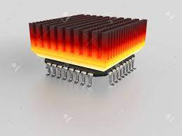
Contd..
limitations
Limitations of fabrication of integrated circuits.
Power and heat restrictions as well as a rapidly approaching physical limit to transistor size.
Overcome the Limitations
Personal Computers- three-, four-, six-, and eight-core central processor units

Slide 7
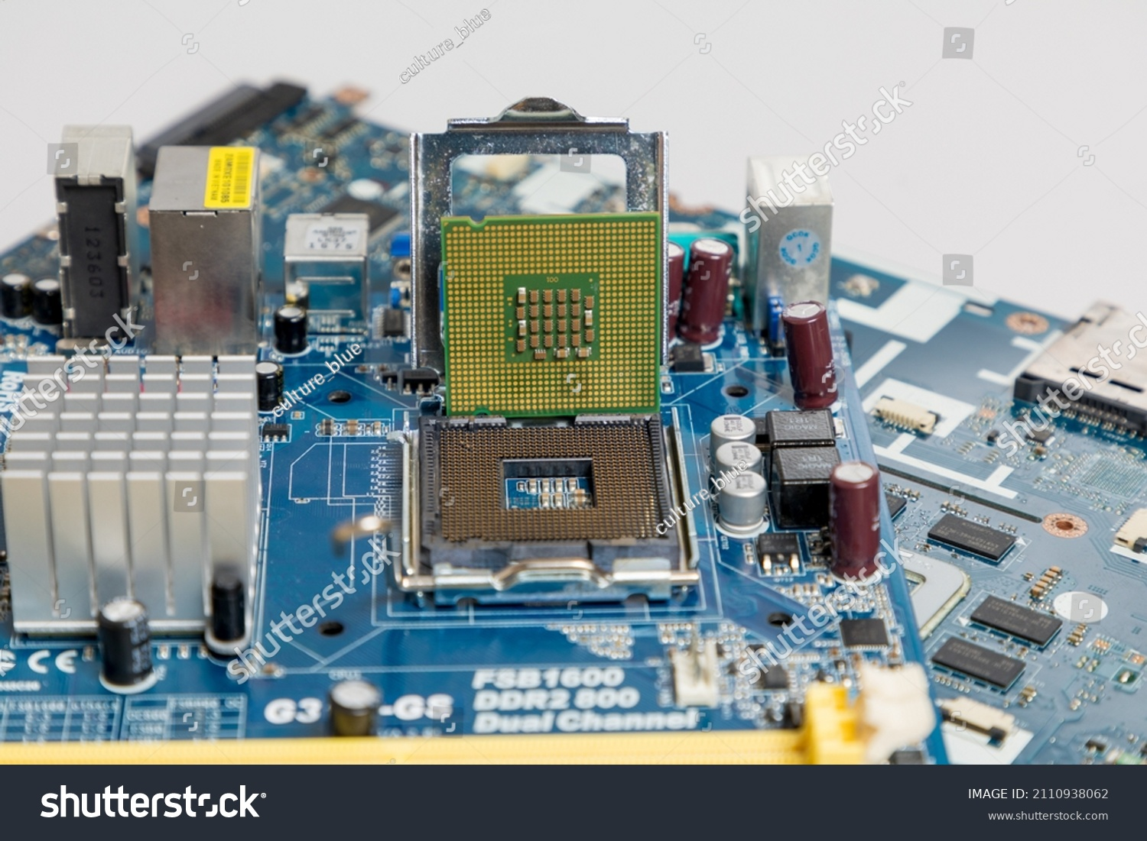

Slide 8
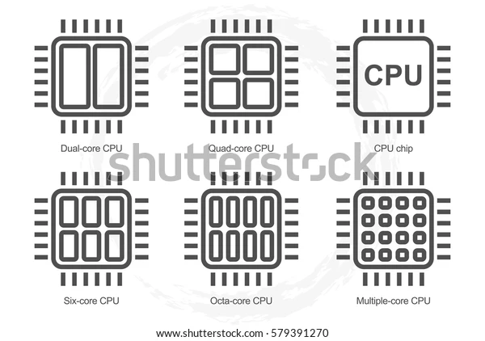
Contd..

Slide 9
The Rise of GPU Computing
A Brief History of GPU
In the late 1980s and early 1990s, the growth in popularity of graphically driven operating systems such as Microsoft Windows helped create a market for a new type of processor.
1990s-2D display accelerators are used for the personal computers. These display accelerators offered hardware-assisted bitmap operations to assist in the display and usability of graphical operating systems.

Slide 10
Contd..
1992- Silicon Graphics opened the programming interface to its hardware by releasing the OpenGL library. Silicon Graphics intended OpenGL to be used as a standardized, platform-independent method for writing 3D graphics applications
1992s
1. Doom, Duke Nukem 3D, and Quake helped ignite a quest to create progressively more realistic 3D environments for PC gaming.
2.NVIDIA, ATI Technologies, and 3dfx Interactive began releasing graphics accelerators that were affordable computing enough to attract widespread attention.

Slide 11
Contd.
NVIDIA’s GeForce 256-transform and lighting computations could be performed directly on the graphics processor, thereby enhancing the potential for even more visually interesting applications.
NVIDIA’s release of the GeForce 3 series was the computing industry’s first chip to implement Microsoft’s then-new DirectX 8.0 standard.

Slide 12
Early GPU Computing
The GPUs of the early 2000s were designed to produce a color for every pixel on the screen using programmable arithmetic units known as pixel shaders.
A pixel shader uses its (x,y) position on the screen as well as some additional information to combine various inputs in computing a final color.

Slide 13
The additional information could be input colors, texture coordinates, or other attributes that would be passed to the shader when it ran.
The arithmetic being performed on the input colors and textures was completely controlled by the programmer, researchers observed that these input “colors” could actually be any data
Inputs were actually numerical data signifying something other than color, programmers could then program the pixel shaders to perform arbitrary computations on this data.
The results would be handed back to the GPU as the final pixel “color,” although the colors would simply be the result of whatever computations the programmer had instructed the GPU to perform on their inputs.

Slide 14
CUDA Architecture
The GeForce 8800 GTX was also the first GPU to be built with NVIDIA’s CUDA Architecture.
The CUDA Architecture included a unified shader pipeline, allowing each and every arithmetic logic unit (ALU) on the chip to be marshaled by a program intending to perform general-purpose computations.
NVIDIA intended this new family of graphics processors to be used for general-purpose computing.
The execution units on the GPU were allowed arbitrary read and write access to memory as well as access to a software-managed cache known as shared memory.

Slide 15
Using the CUDA Architecture
CUDA C became the first language specifically designed by a GPU company to facilitate general-purpose computing on GPUs.
A specialized hardware driver to exploit the CUDA Architecture’s massive computational power.

Slide 16
Applications of CUDA
Medical Imaging
Computational fluids Dynamics
Environment science

